Slide 1
DriveTime Delinquency
Samuel York
Data Scientist Assignment

Slide 2
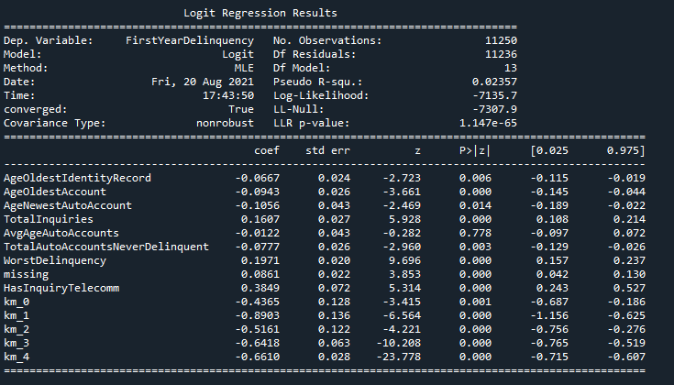
Model Results
AUC: 0.6

Slide 3
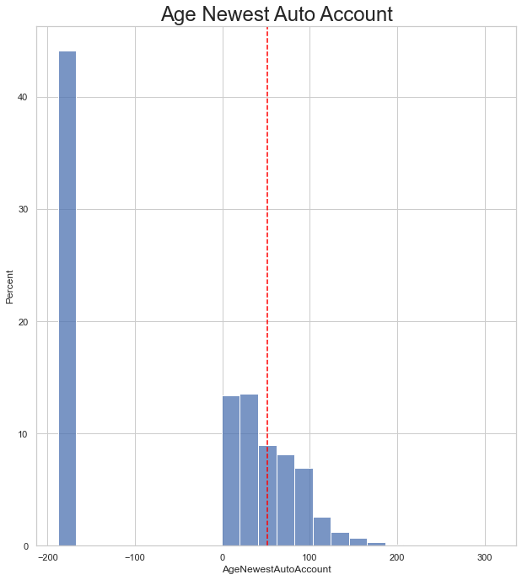
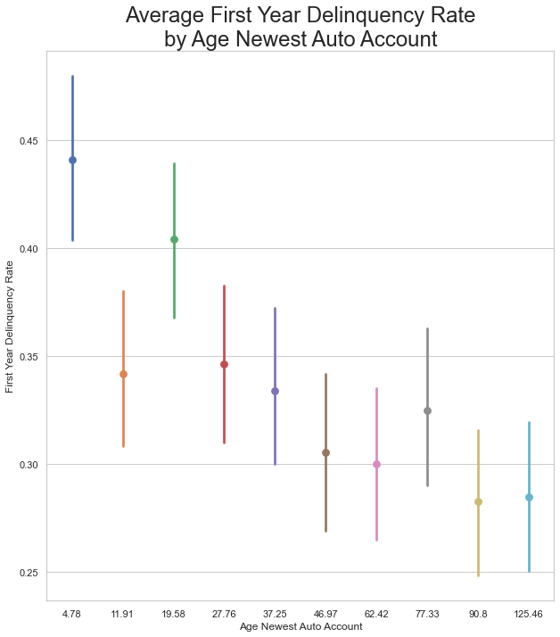
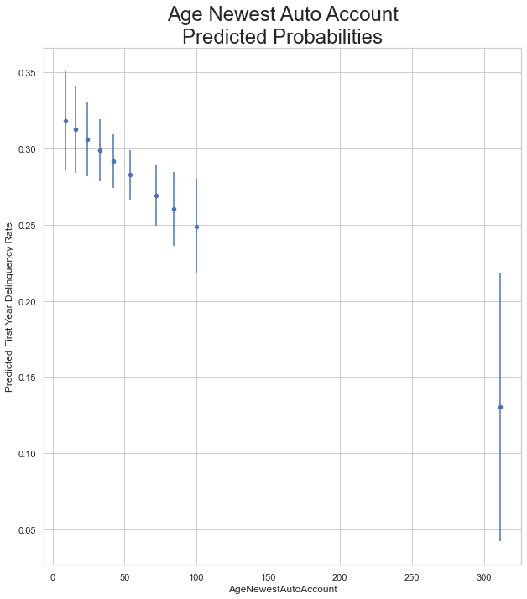
Model Results – Age of Newest Auto Account
Take Away
Negative Effect of Newest Account Age on Probability of First Year Delinquency; across the range of values for the same customer, as age of newest auto account increases from 0 to 100 months old the probability of First Year Delinquency decreases by about 7%
Observations are binned in 10 percentile groups, so the first dot is the lowest 10% of customers, and the last is the highest 10%
Largest effect is at the tail which could be an age effect (i.e. people who got a car 300+ months ago are going to be older)
Data is skewed right, contains lots of missing values (indicated by negative values in histogram) and has a mean of 50.9

Slide 4
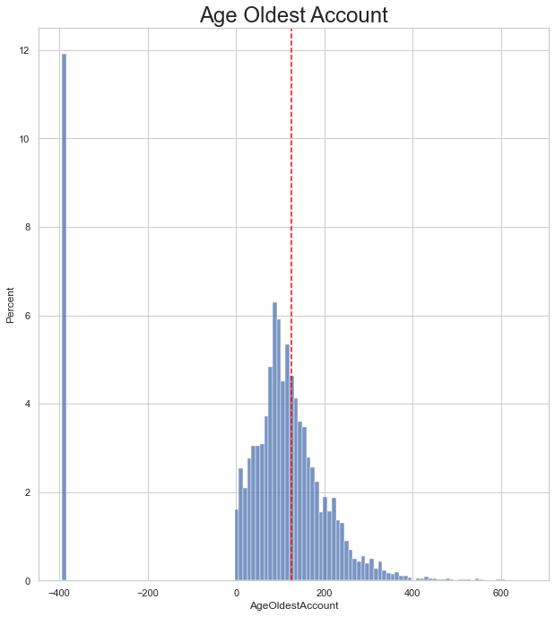
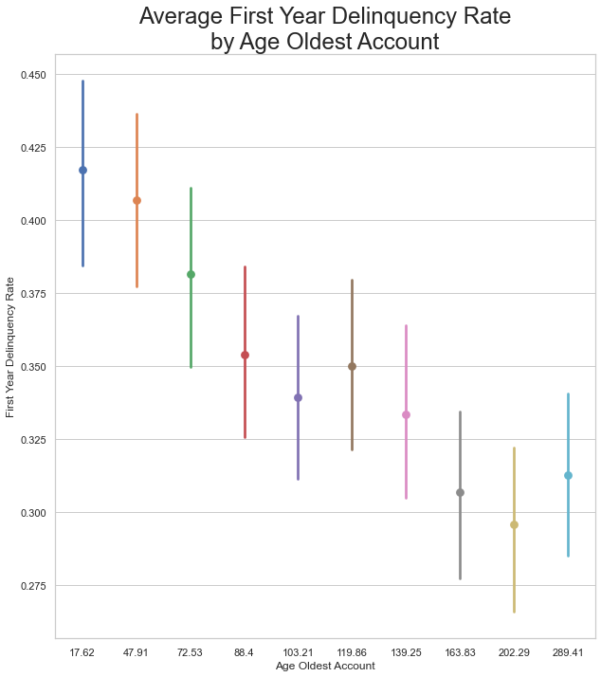
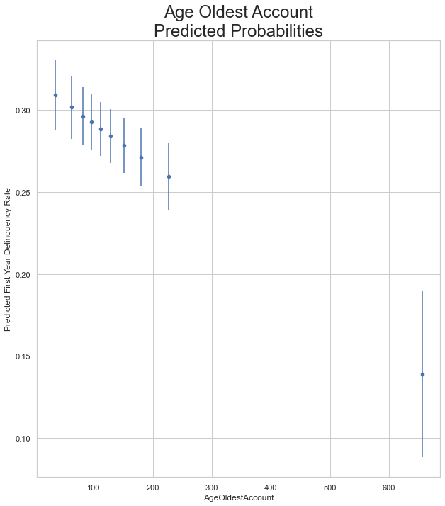
Model Results – Age of Oldest Account
Take Away
Negative Effect of Oldest Account Age on Probability of First Year Delinquency; across the range of values for the same customer, as age of oldest account increases from 0 to 250 months old the probability of First Year Delinquency decreases by about 5%
Observations are binned in 10 percentile groups, so the first dot is the lowest 10% of customers, and the last is the highest 10%
Largest effect is at the tail which could be an age effect (i.e. people who got a car 300+ months ago are going to be older)
Data is skewed right, contains lots of missing values (indicated by negative values in histogram) and has a mean of 125

Slide 5
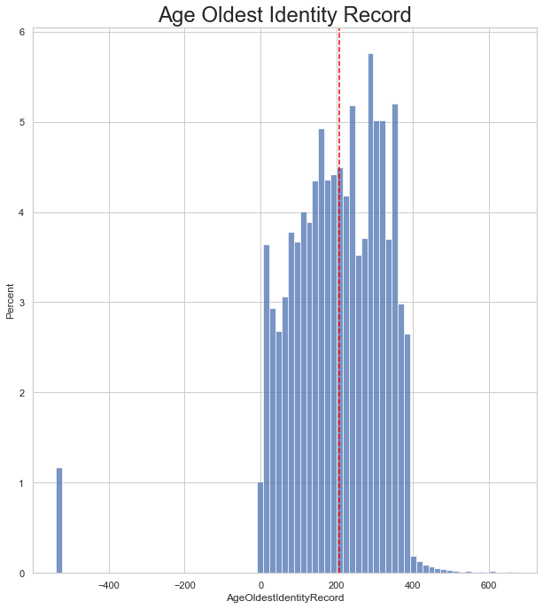
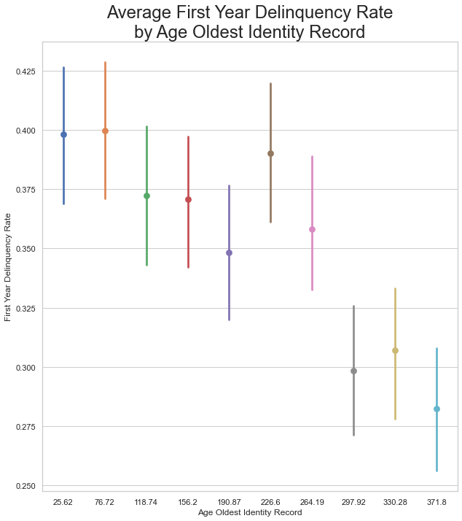
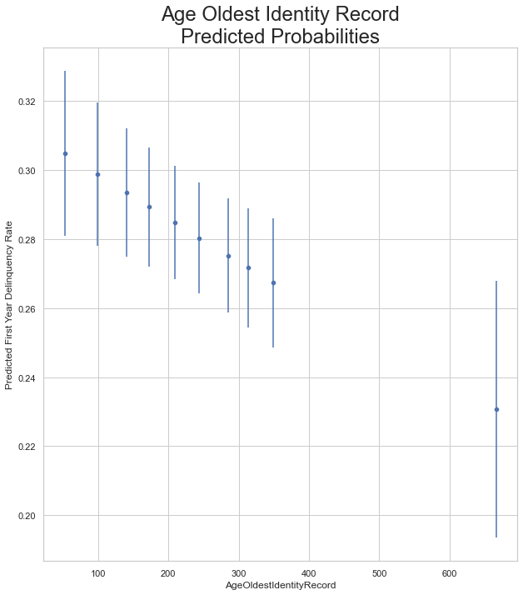
Model Results – Age of Oldest Identity Record
Take Away
Weak Negative Effect of Oldest Account Age on Probability of First Year Delinquency; across the range of values for the same customer, as age of oldest account increases from 0 to 350 months old the probability of First Year Delinquency decreases by about 3%
Observations are binned in 10 percentile groups, so the first dot is the lowest 10% of customers, and the last is the highest 10%
Largest effect is at the tail which could be an age effect (i.e. people who got a car 300+ months ago are going to be older)
Data is fairly symmetrical, without many missing values and has a mean of 206

Slide 6
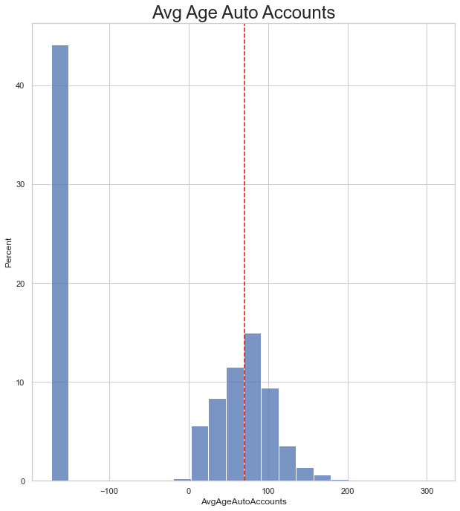
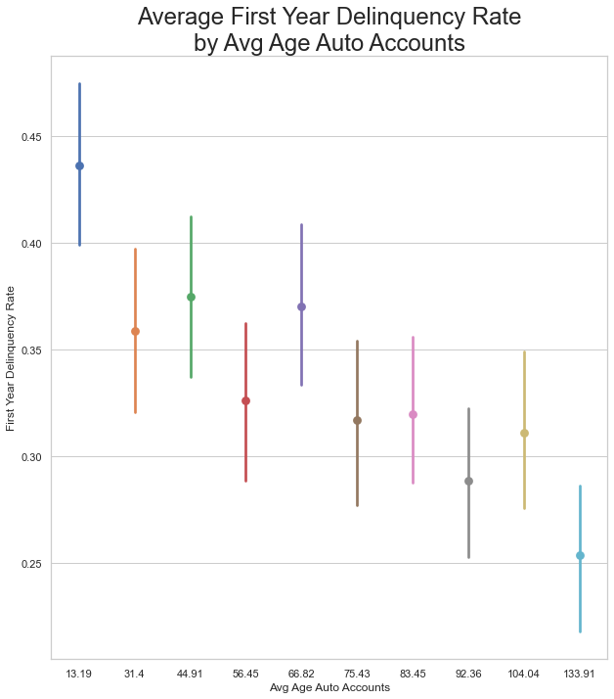
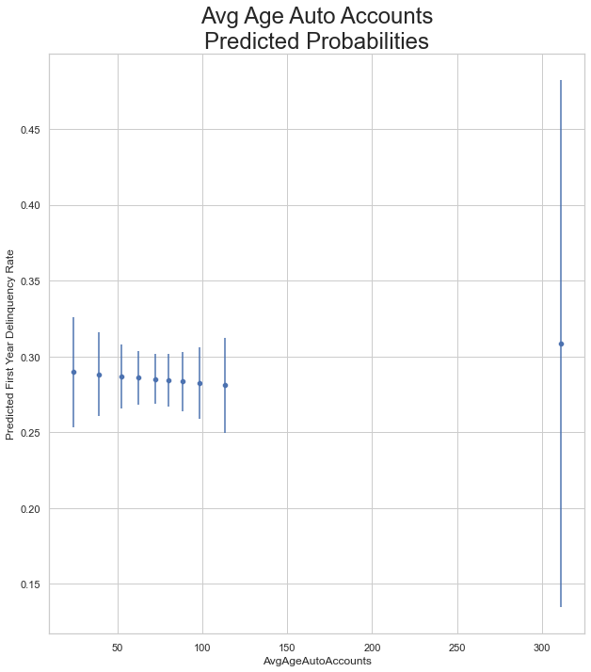
Model Results – Average Age of Auto Accounts
Take Away
Bivariate average indicates a negative relationship between Average Age of Auto Accounts and First Year Delinquency Rate, however the predicted probabilities indicate a fairly flat relationship
Missing data imputation tends to flatten relationships between variables, so with almost 50% of the data missing a weak relationship isn’t necessarily surprising, though, a relationship could emerge with higher quality data
Good candidate for removal from the model, but I’d want to test how removal effects KMeans clusters before doing so

Slide 7
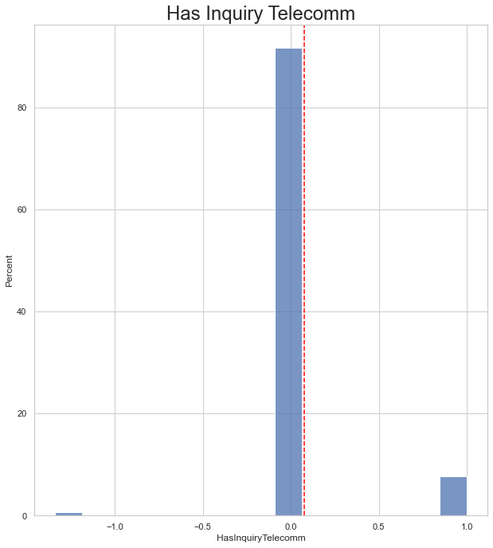
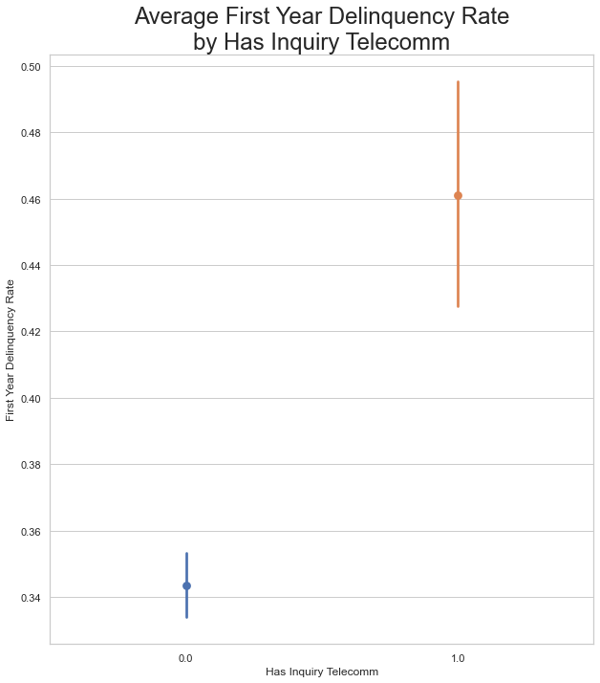
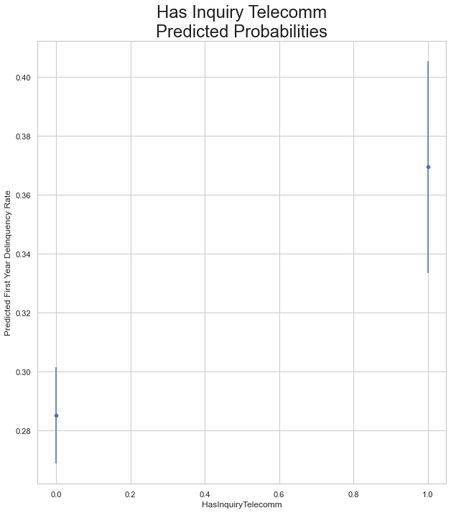
Model Results – Has Telecommunications Inquiry
Take Away
Strong positive relationship between having a telecom inquiry and first year delinquency; individuals with a telecom inquiry are almost 10% more likely to go delinquent their first year (though the standard intervals on that are a bit wide)
Very little missingness, so a good predictor on that front, however, it is highly skewed with over 90% of customers never having a telecom inquiry

Slide 8
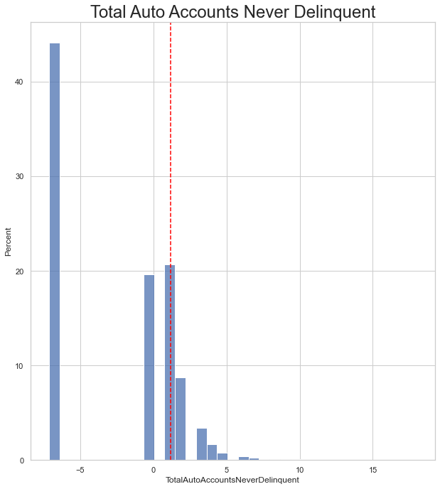
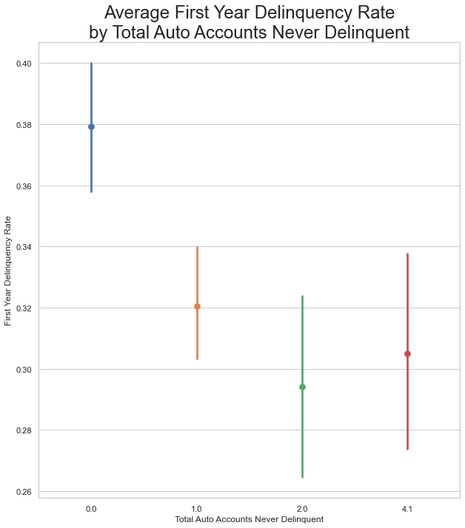
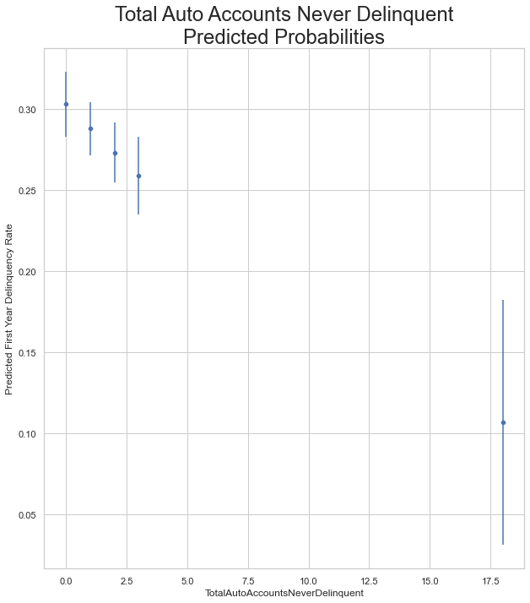
Model Results – Total Auto Accounts Never Delinquent
Take Away
Negative relationship between Never Delinquent Auto Accounts and First Year Delinquency Rate; moving from zero accounts never delinquent (so all their accounts were delinquent) to 3 accounts never delinquent is only associated with a 4% decrease in First Year Delinquency Rate
Almost 50% of the data is missing, but the relationship is still significance, so better data quality might improve the model here
Again, could be correlated with age, since older people probably have more accounts, but less of a clear relationship here

Slide 9
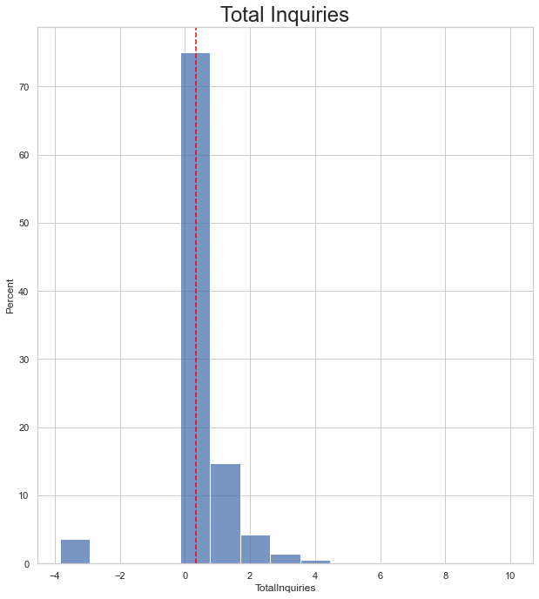
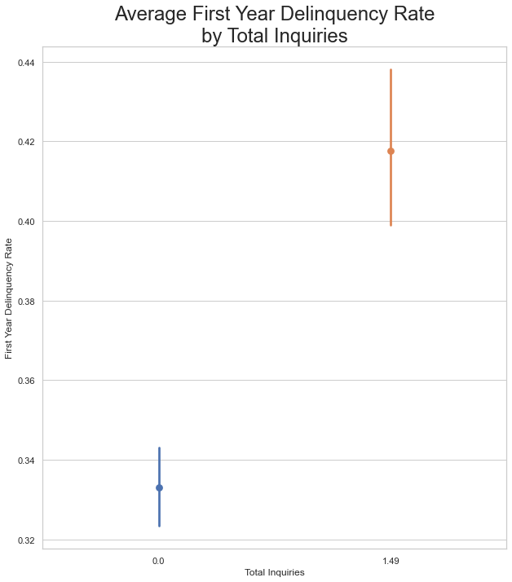
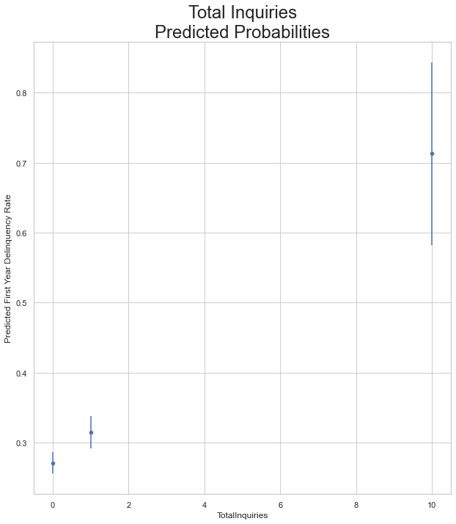
Model Results – Total Inquiries
Take Away
Very strong relationship; individuals with at least one inquiry are 9% more likely to experience delinquency in their first year compared to similar individuals without any inquiries
Right skewed data, with little missingness, and a mean of 0.33

Slide 10
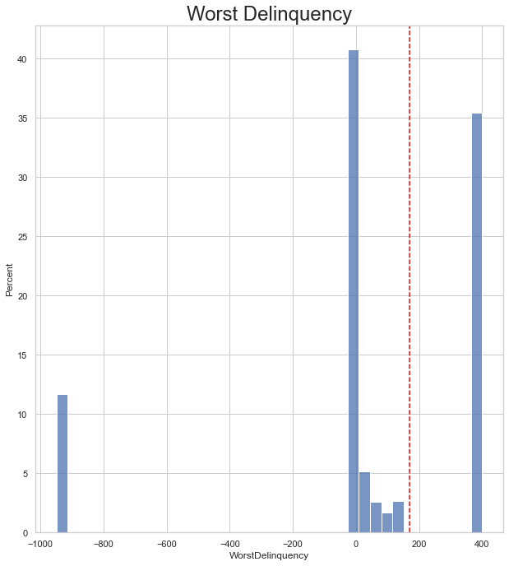
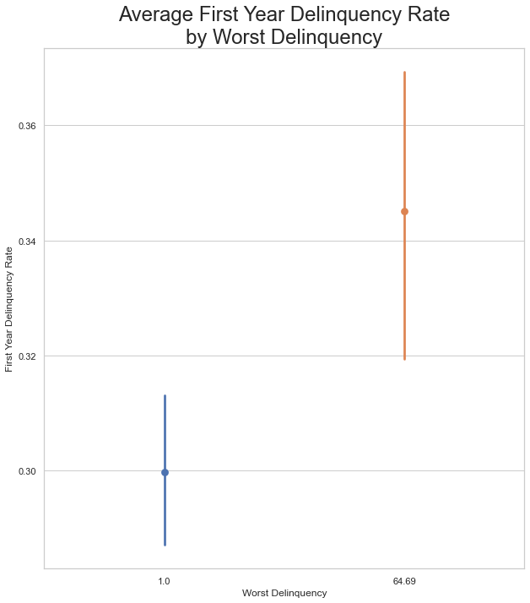
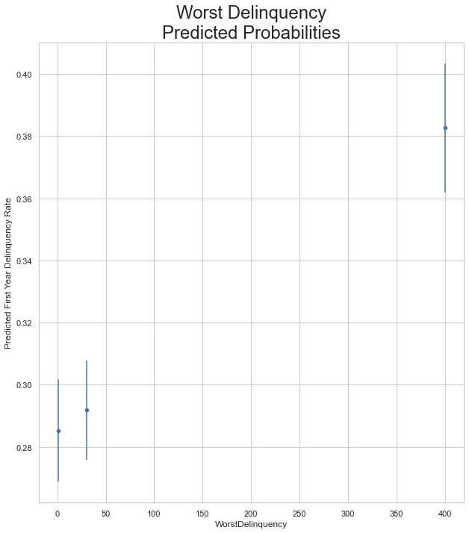
Model Results – Worst Delinquency
Take Away
Weak positive relationship between worst delinquency and first year delinquency rate; similar individuals with a worst delinquency greater than one are 5% more likely to experience First Year Delinquency, with very wide standard errors
Could probably be recoded as a dummy for simplicity (<400 or 400+), but it is unlikely that would change the model much
Fairly balanced data with about half of the observations being below 400 and half being 400 (or above), mean is 170

Slide 11
Model Results – Conclusion/Findings
Limited model efficacy due to poor data quality
Multiple features have missing values for close to 50% of observations
Missing data imputation helps preserve what trends exist in the data, but it is no substitute for real data
Limited model efficacy due to poor feature quality
Many of the features seem to target the same idea, which could just be proxies for unseen variables (i.e. the age of the customer)
All features target credit related factors, while leaving out factors about the customer (e.g. income), dealer, vehicle, and structure of the loan; all of which could improve performance
Overall Findings
Low risk individuals tend to have a more well-established credit history (potentially older), with fewer historical delinquencies and fewer telecom inquiries

Slide 12
Model Selection
Final Model Selection was a Logistic Regression with a Cross Validated ROC AUC of 0.6
Feature selection was conducted by examining all possible combinations of variables; normally this is prohibitively timely, but there were only 14 features so in this case it only took 20-30 minutes
Logistic regression was designed as the “simple” model, so no interactions or polynomial terms were included; if those are important, they should show up in one of the other methods (e.g. neural networks will automatically detect interactions)
The model including all 14 features had the highest (tied for the highest, technically) Cross Validated ROC AUC score, therefore, it was chosen as the best logistic regression
ROC AUC
ROC AUC was chosen over other possible metrics because it directly indicates how good a model is at ranking predictions, which directly relates to our primary concern of differentiating low risk accounts from high risk accounts.

Slide 13
Model Selection
Final Model Selection was a Logistic Regression with a Cross Validated ROC AUC of 0.6
ROC AUC
ROC AUC was chosen over other possible metrics because it directly indicates how good a model is at ranking predictions, which directly relates to our primary concern of differentiating low risk accounts from high risk accounts.
Random Forest Classifier
Cross Validated ROC AUC: 0.55
Optimized over Number of Estimators
Gradient Boosting Classifier
Neural Network

Slide 14
Model Selection
Random Forest Classifier
Cross Validated ROC AUC: 0.55
Optimized over Number of Estimators
Gradient Boosting Classifier
Cross Validated ROC AUC: 0.6
Same score as the logit but much more computationally expensive
Optimized over Number of Estimators, Max Depth, and Learning Rate
Neural Network
Cross Validated ROC AUC: 0.6
Same score as the logit, but less intuitive/interpretable
Optimized over number of layers, neurons, epochs, drop rate, and learning rate

Slide 15
Model Selection
Random Forest Classifier
Gradient Boosting Classifier
Neural Network
Missing Data Imputation
Used simple mean imputation with mode imputation on the categories
Also tested KNN Imputation and Iterative Imputation, but neither effected performance
Other Notes
Implemented Standard Scaling to normalize data, other scaling methods could have been tested to see if that impacted performance, but were not tested
Kmeans clusters were included, other clustered should be tested to see if they improve performance

Slide 16
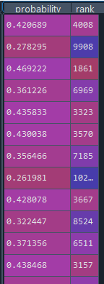
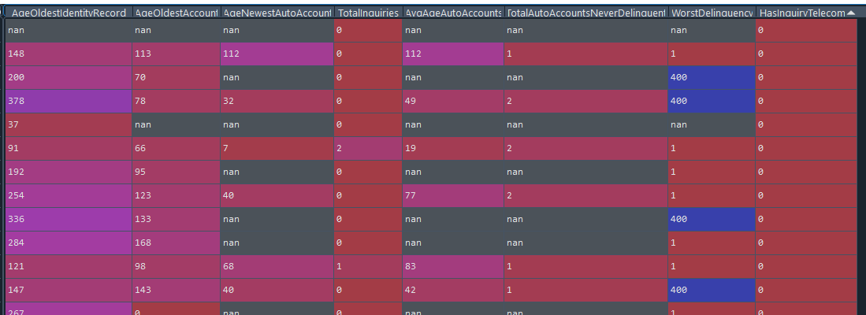
Pipeline
Input: File Name or DataFrame
Output: Probabilities or Ranking

Slide 17
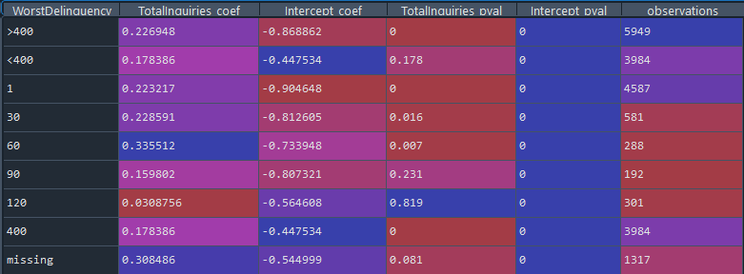
Worst Delinquency

